Slide 1
BOT Framework

Slide 2
@hmheng
@hmheng
The way how we interact with computer has change over time.

Slide 3

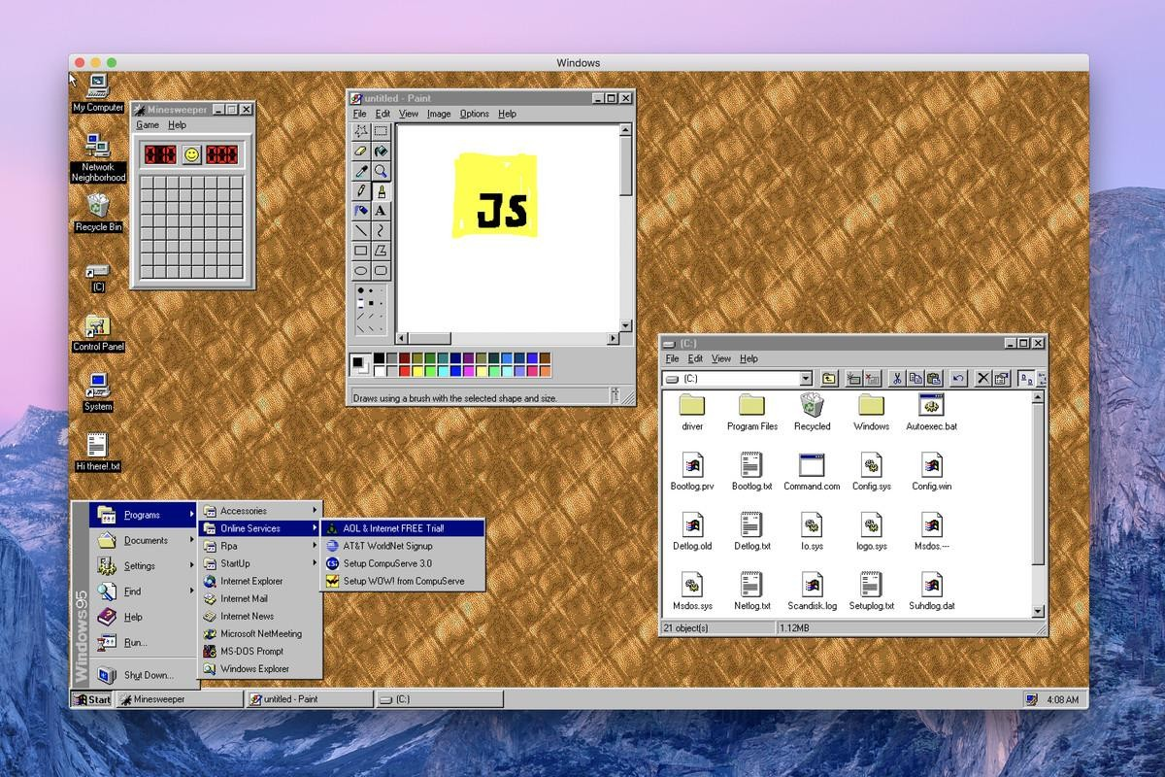
1990s

Slide 4

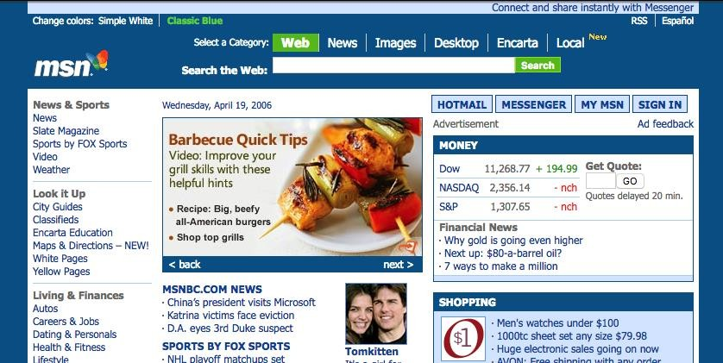
2000s

Slide 5

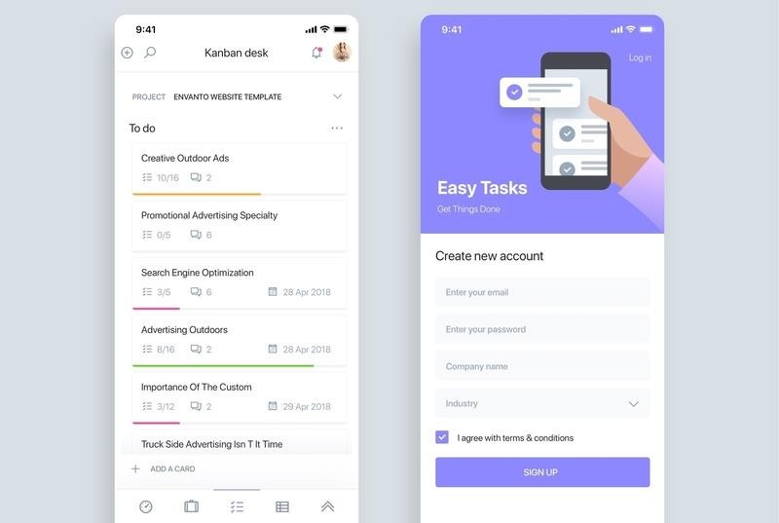
2000s

Slide 6



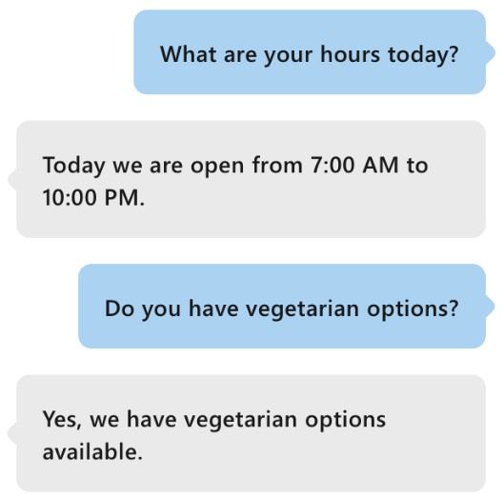
2000s

Slide 7



How Does Chatbot Help?

Slide 8
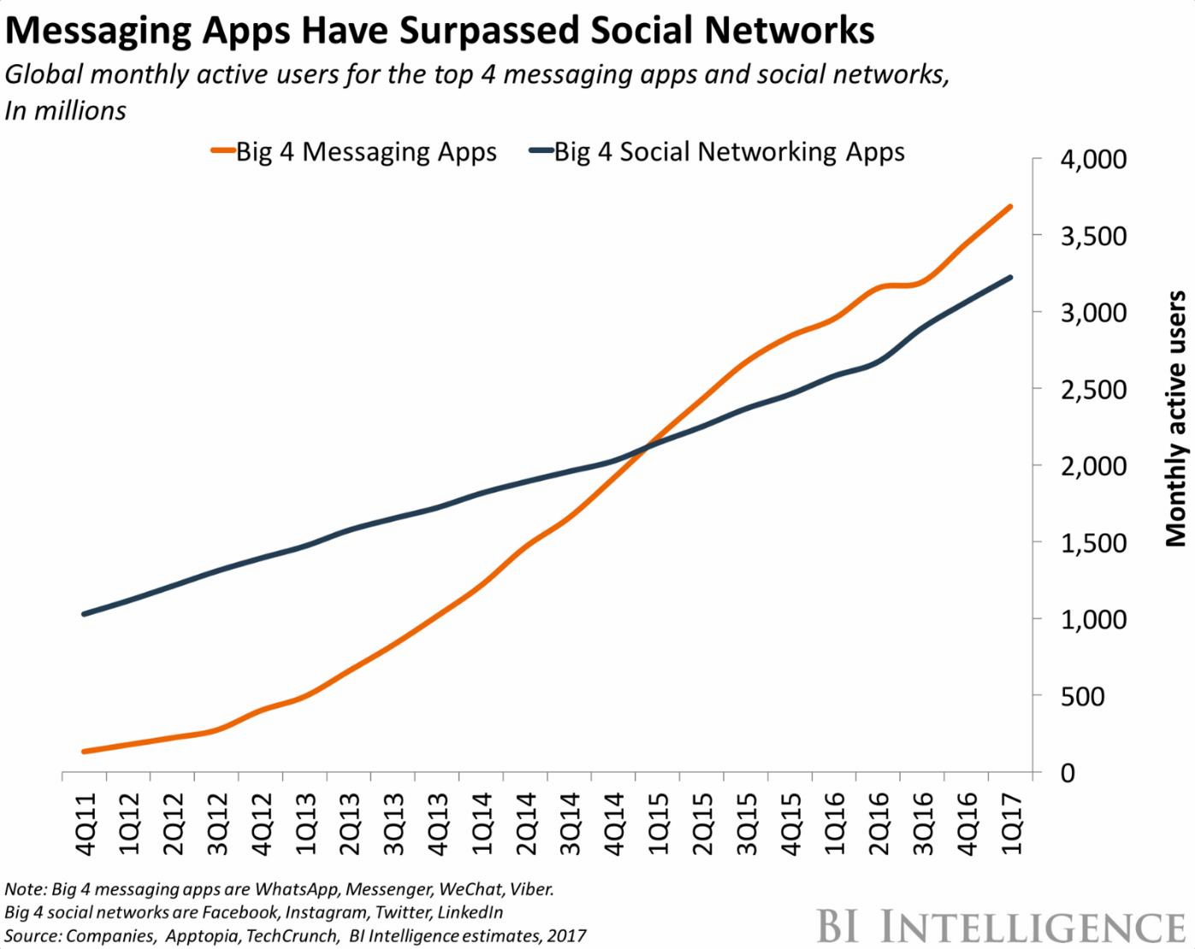

Slide 9
Reduce Human Error
Handle Uncomplicated Tasks
Save Cost on Customer Service
Create Engagement

Slide 10

What is a Bot?

Slide 11
What is a Bot?
Bot is a virtual assistant that simulates human interaction.
For Bot Framework, it is a web api.

Slide 12
What is a Bot?
Bot is a virtual assistant that simulates human interaction.
For Bot Framework, it is web services.

Slide 13
Bot Framework
SDK for developing bots
Tools to cover end-to-end bot development workflow
Bot Framework Service (BFS) to send and receive messages and events between bots and channels
Bot deployment and channel configuration in Azure

Slide 14
Multiple Channels
Website Embedded Code
Direct Line
Email
Cortana
Teams
Skype
Line
Facebook
Telegram…..

Slide 15
List 3 benefits of using chatbot in your business.

Slide 16

Building A Bot

Slide 17
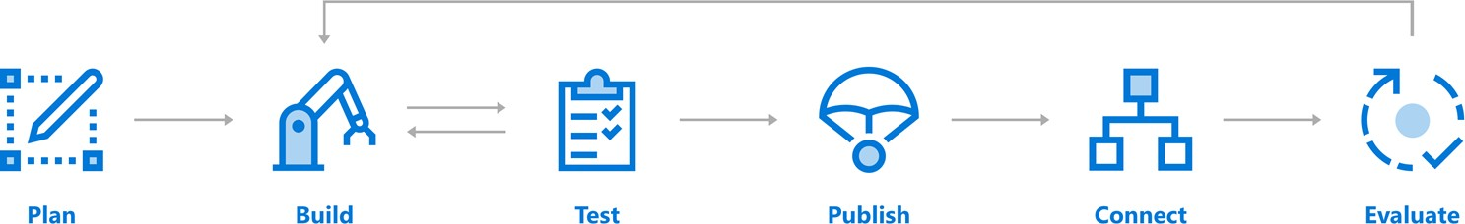
Building A Bot

Slide 18

Building A Bot
Understand the goal, processes, flow
Review design Guidelines
Identify features that are required

Slide 19

Building A Bot
Implements a conversational interface and communicates with the Bot Framework Service to send and receive messages and events
Extends the capabilities with Cognitive services

Slide 20

Building A Bot
Test your bot locally with the emulator
Test your bot on the web

Slide 21

Building A Bot
Publish your bot to Azure or to your own web service or data center.
Setting up your virtual infrastructure and services.

Slide 22

Building A Bot
Connect your bot to channels, such as Facebook, Skype, Line, Telegram, etc.
Embed your bot on your websites.

Slide 23

Building A Bot
Azure provides conversation-level reporting on user, message, and channel data

Slide 24
Building A Bot

Slide 25
context.activity.locale
This reads user’s locale to determine which
language will it be using.
It may be undetectable sometimes.

Slide 26
context.activity.text
This reads the message being input by the users.
Prompt user to choose their language or connect to Microsoft Language

Slide 27
List 5 channels that Bot Framework supports.

Slide 28

Demo

Slide 29
Why NLU?
Rise of conversation-based applications
Need to extract meaning from context
Problem
We are not all data scientists, but we all need to be able to integrate NLU into our applications
Background
Notes:
Understanding NLU Stanford presentation: https://nlp.stanford.edu/~wcmac/papers/20140716-UNLU.pdf
Wikipedia: https://en.wikipedia.org/wiki/Natural_language_understanding
Why chatbots won’t survive without NLU: https://chatbotsmagazine.com/why-chatbots-wont-survive-without-nlu-df3670e911c5

Slide 30
Microsoft's Language Understanding Intelligent Service (LUIS)
A machine learning-based service to build natural language understanding into apps, bots, and IoT devices
Quickly create enterprise-ready, custom models that continuously improve
Can configure with a rich UI or programmatically
Background
Notes:
LUIS whitepaper: https://www.microsoft.com/en-us/research/wp-content/uploads/2016/02/sigdial2015demo.pdf
https://www.luis.ai/

Slide 31
Demo
Notes:
Include a brief demo of the published bot

Slide 32
Developing LUIS Models
Intents
Utterances
Entities
Training and testing
Publishing
Features
Active learning
(preview) Patterns

Slide 33
Key LUIS concepts
Intents
Actions the user wants to perform
Utterances
Text input from a user your app needs to understand
Entities
Detailed information that is relevant to the utterance
Intent | Sample user utterance | Entities
BookFlight | “Book a flight to Seattle?” | Seattle
StoreHoursAndLocation | “When does your store open?” | open
ScheduleMeeting | “Schedule a meeting at 1PM with Bob in Distribution” | 1PM, Bob
Developing LUIS models
Notes:
1. https://docs.microsoft.com/en-us/azure/cognitive-services/luis/home

Slide 34
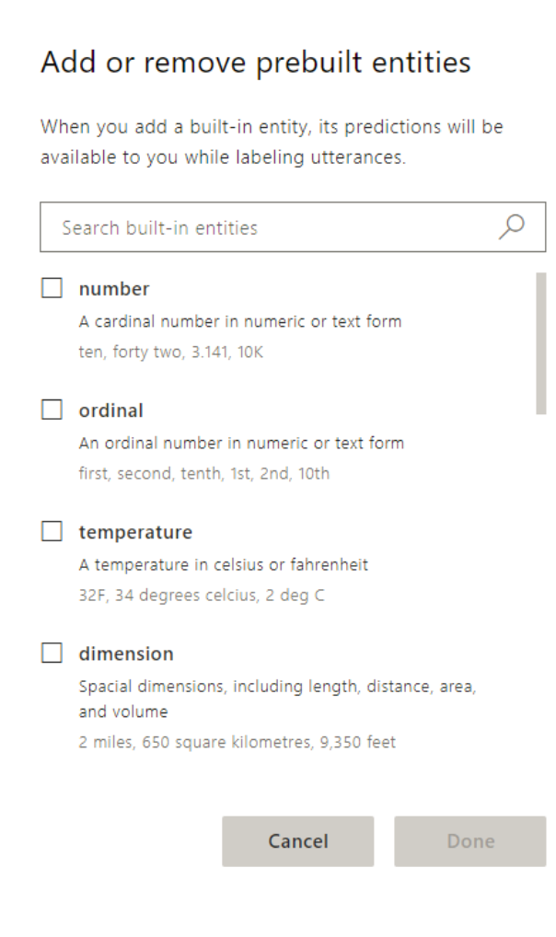
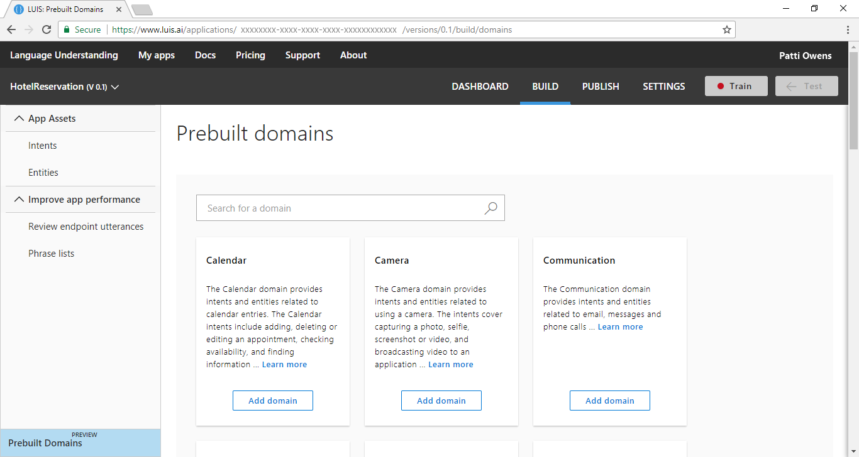
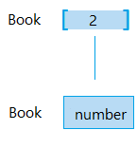
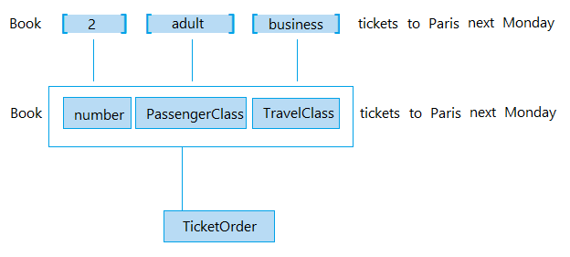
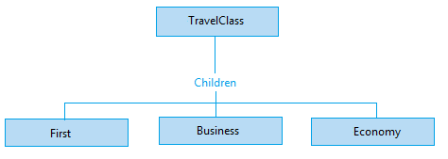
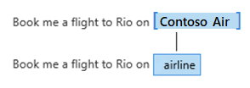
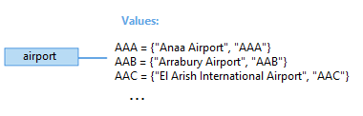
Key LUIS concepts
Simple entities
Hierarchical entities
Composite entities
Prebuilt entities
List entities
Developing LUIS models
Notes:
Plan your app: https://docs.microsoft.com/en-us/azure/cognitive-services/luis/plan-your-app
Prebuilt entity: https://docs.microsoft.com/en-us/azure/cognitive-services/luis/pre-builtentities
Prebuilt domains: https://docs.microsoft.com/en-us/azure/cognitive-services/luis/luis-how-to-use-prebuilt-domains
Best practices: https://docs.microsoft.com/en-us/azure/cognitive-services/luis/luis-concept-best-practices#entities
Recognizer-Texts, code behind prebuilt entities: https://blog.botframework.com/2018/01/24/contributing-luis-microsoft-recognizers-text-part-1/

Slide 35
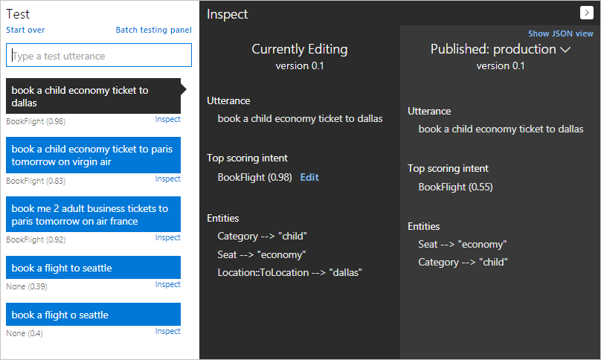
Training and testing your model
Developing LUIS models
Notes:
Train your model: https://docs.microsoft.com/en-us/azure/cognitive-services/luis/luis-how-to-train
Interactive testing: https://docs.microsoft.com/en-us/azure/cognitive-services/luis/train-test
Batch testing: https://docs.microsoft.com/en-us/azure/cognitive-services/luis/luis-how-to-batch-test

Slide 36
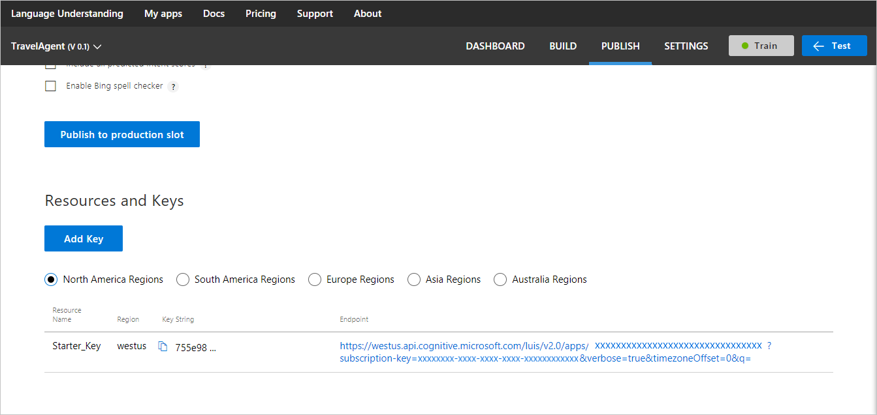
Publishing your model
Developing LUIS models
Notes:
1. Publish your model: https://docs.microsoft.com/en-us/azure/cognitive-services/luis/publishapp

Slide 37
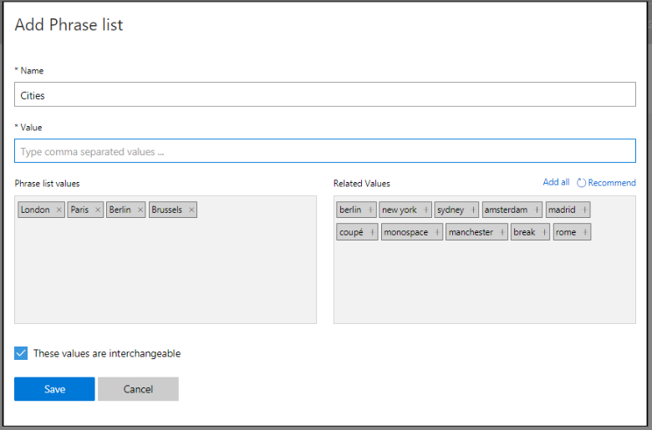
Adding features to improve performance
Features help LUIS by providing hints that certain words and phrases are part of a category
Developing LUIS models
Notes:
Add features: https://docs.microsoft.com/en-us/azure/cognitive-services/luis/add-features
10 phrase list must-haves blog: https://blogs.msdn.microsoft.com/benjaminperkins/2016/12/07/top-10-must-have-phrase-list-features-for-your-chatbot-or-any-bot-luis/

Slide 38
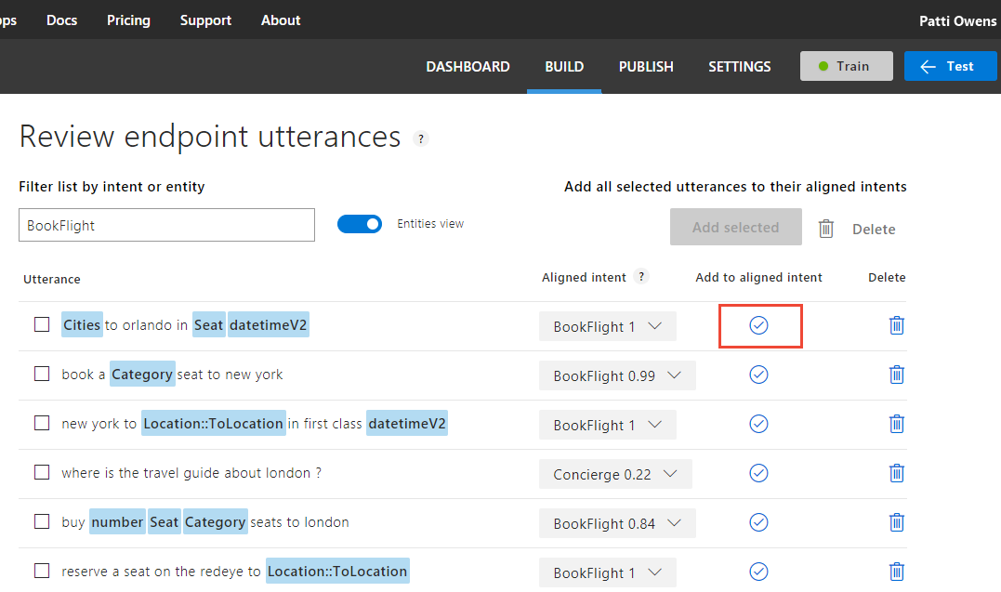
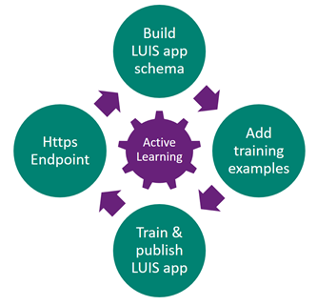
Using active learning
Developing LUIS models
Notes:
Authoring cycle: https://docs.microsoft.com/en-us/azure/cognitive-services/luis/luis-concept-app-iteration
Label endpoint utterances: https://docs.microsoft.com/en-us/azure/cognitive-services/luis/label-suggested-utterances

Slide 39
~preview~ Adding patterns
Example: SearchEmail intent
“email about {Subject} [from {Person:sender}] to {Person:receiver}]”
Subject and person are open-ended pattern.any
Person can have role of sender or receiver
“find email about dogs from chris”
Matches with Subject=dogs and Person=chris
“email about dogs from asia”
Matches with Subject=dogs and Person=asia
Fix by adding “dogs from asia” to explicit phrases for Subject
{ } for entities
[ ] for optional
Pattern.any as new entity type
Matches between keywords
To include keyword, add to explicit list
Pattern.any as roles
Fly from {City:origin} to {City.destination}
Plan to release at build
Developing LUIS models

